Slide 1
Teaching & Coaching:
Patient Safety Science and the Model for Improvement
January 2017

Slide 2
Stop “Putting out Same Fires” Everyday!
Practice managers/staff - often dealing with familiar problems
  Sometimes feel stuck - “what are you going to do?”
  Feel “helpless” but we want to help this patient so we just address it for this patient, and the next… but we don’t solve the underlying problem
Learning and using improvement skills
  Gives you the confidence to work with your team
  Define aim - Test changes
  Implement proven solutions
  Fix the problem once and for all
You are not helpless – you can fix the problem once and for all!
Notes:
Practice managers/staff - often dealing with familiar risks
that problem that just keeps popping up.
you figure out how to deal with it each time. And then again the next time and the next times.
Sometimes feel stuck - “what are you going to do?”
Feel “helpless” but we don’t want anyone to get hurt so we just fix it again.
This project is about giving you the improvement skills and the confidence to stop putting out fires and, instead, fix the problem once and for all!
If you can clearly state what the problem is and set an improvement aim, then you and your team can identify some changes that might fix the problem, test those changes, measure outcomes, and implement changes that work.

Slide 3
Table of Contents
Slides
Patient Safety - Science and Culture 3 - 45
What Drives Good or Bad Outcomes
Systems Thinking
Safety Culture
Communication
Engaging Patients
The Model for Improvement (MFI) and 46 - 54
Plan, Do, Study, Act (PDSA) Test Cycles
Process Improvement Check List 55 – 64
Appendix: Tools, Videos 65 - 73

Slide 4
What drives good or bad outcomes for patients?
Daily work – everyday operations:
1. System Design
- are work processes well designed?
- are defined work processes followed?
2. Culture
Patient
Outcomes
Improving daily work:
1. Culture including commitment to safety
and continual learning
2. “See problems”
3. “Solve problems”

Slide 5
What drives good or bad outcomes for patients?
Daily work – everyday operations:
1. System Design
- are work processes well designed?
- are defined work processes followed?
2. Culture
Patient
Outcomes

Slide 6
Science of Patient Safety
Systems thinking
  Most problems do not result from individual workers; but from the design of work processes/system
Safety culture
  Leadership & values
  Teamwork & communication
  Trust, psychological safety
What if you started your staff meetings with the question:
“Do you have any patient safety concerns we should talk about?”
Notes:
We don’t blame the people, we improve the system in which they work
Every system is perfectly designed to get the results it gets; if we want to improve results we need to improve system
Insanity is doing the same thing over and over and expecting different results
Safety culture starts from the top, as defined by leadership beliefs and core values
What if you started your staff meetings with the question: “Do you have a patient safety concern we can talk about?”
Requires teamwork and communication
And atmosphere of trust, where individuals feel safe to share information about unsafe or potentially hazardous conditions so that we can identify strategies for improvement

Slide 7
Systems Thinking: If we want better performance, we must improve the system
Most problems in organizations do not come from individual workers.
Most problems come from the structure of the systems themselves.
People doing the work can’t produce better results if the problem is built into the system – the work processes
Notes:
Changing the people, or pushing them to "try harder" or "do better" will not result in improved performance.

Slide 8
Human Error Models
The “bad employee” model –
  “Names, blames, and shames" an individual(s) as "causing" the accident.
  Assumes mistakes and errors are the result of negligence, inattention, carelessness, lack of skill or knowledge, lack or motivation.
  This model uses fear and discipline to attempt to improve safety.
  “Bad things happen because of bad people."
Notes:
Person Model: This is the traditional approach to human error that "names, blames, and shames" an individual(s) as "causing" the accident. The underlying assumption is that mistakes and errors are the result of negligence, inattention, carelessness, lack of skill or knowledge, lack or motivation or one of a host of other faulty, negative mental processes. This model uses fear and discipline to attempt to improve safety. The person model considers errors as a "moral" issue that "bad things happen to bad people."*

Slide 9
Human Error Models
System model –
  Recognizes that systems cause most errors.
  Acknowledges that the organizational culture, design of work processes, can set workers up to fail. ("latent failures“)
  Recognizes human limitations and that humans make errors
  Systems should be designed to anticipate human error and avoid harm to the patient.
  “ High reliability organization”

Slide 10
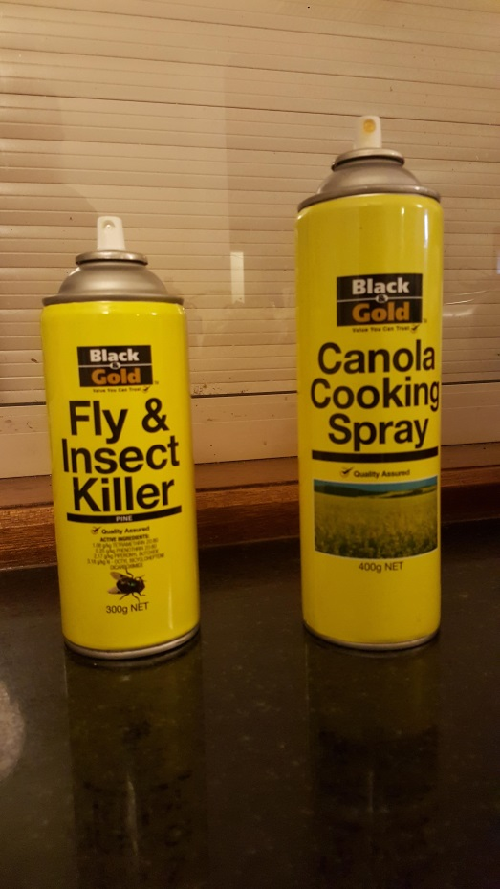
Designing Work Processes
How can we make it easy
to do the right thing?
And hard to do the
wrong thing?

Slide 11
Safety Culture: Key Aspects
Leadership & Values
A “Just” Culture/Psychological Safety
Communication
Teamwork
Staff Empowerment/Engagement
Patient/Family Engagement
Notes:
The most important aspects of safety culture comprises the human elements (as above) not just improvements in methods or technology

Slide 12
Leadership & Values
Commit to consistently safe operations
Acknowledge risk - organization’s care processes could harm patients
Systems thinking - Recognize system contributions to harm & error
Encourage collaboration across all levels of staff/all roles to seek solutions to patient safety problems
Leadership provides resources to address safety concerns
Commitment to ongoing learning and improvement
Role model – “walk the talk”

Slide 13
A “Just Culture”/Psychological Safety
Identifies and addresses system issues – don’t punish individuals for issues caused by systems
Define unacceptable behavior/distinguish from mistakes (or “drift” to risky behavior)
  Reckless behavior: Intentionally disregarding reasonable rules or consistently refusing to change
  Zero tolerance for recklessness – from anyone
Build atmosphere of trust – drive out fear
Encourage/reward reporting of errors, near misses, concerns

Slide 14
Open communication
“Transparency” - Everyone is open about outcomes and errors
High comfort level with questions and input - shame is taken out of all discussions
Improvements are developed with all levels of staff and shared/explained with all staff
“Every defect is a gem” – learning from errors

Slide 15
Teamwork
Clear organizational values for teamwork:
  treat each other with respect
  pitch in to accomplish shared goals
  Speak up about safety in spite of hierarchy/power gradient

Slide 16
Staff Empowerment/Engagement
Front-line staff are the experts in their own work
  Include staff in improvement projects and audit teams
  All staff - “ unusual suspects”
Speak up about safety in spite of hierarchy/power gradient
Celebrate successes, acknowledge ideas contributions

Slide 17
Patient/Family Engagement
How do we engage patients in this work?
Empower patients to speak up in their own care
Patients’ perspective – identifying defects
Patients’ suggestions for improvements
Patients’ reaction to changes tested
Patients on your improvement team

Slide 18
Improving Safety Culture
Targeting Everyday Behaviors
  How are errors being dealt with today?
  How comfortable are staff with each other?
  How are staff disagreements handled?
  How are questions being answered
Other Strategies
  Get Rid of a Blame Culture
  Identify What is Going Right
  Develop a Process for Listening
  Encourage Positive Behavior
Notes:
The following are a variety of techniques or ways to think about improving the safety culture in your practice. Something may strike a chord others may not seem to be applicable. The importance here is not to determine the one “right” way of improving the safety culture but to get you thinking about what would be the best way to start changing things in your practice.

Slide 19
Get Rid of a Blame Culture
A culture of blame results in:
  Lack of personal responsibility or accountability
  Reluctance in staff to identify and report mistakes
  Reluctance in staff to self identify weaknesses and a seek help
  Increased blaming of others

Slide 20
Identify What is Going Right
Sometimes focusing on the good can increase desired behaviors
Praise, encourage and seek out questions from all staff
When concerns are raised immediately respond in a positive light and include that individual in planning possible improvements

Slide 21
Develop a Process for Listening
When someone brings to light a problem there needs to be a system to:
  Really listen (more than one person hearing the issue)
  Decide who is best to handle it
  Follow up with that person
    Thank them
    Tell them what did or did not change and why

Slide 22
Encourage Positive Behavior
  Respect
    Listen to each other, refrain from finger pointing
  Engagement
    Everyone should have a voice and interest in improving
  Psychological safety
    No official or unofficial reprimands for pointing out areas of improvement
  Prioritization
    Determine these as a group
  Responsiveness to concerns

Slide 23
What drives good or bad outcomes for patients?
Daily work – everyday operations:
1. System Design
- are work processes well designed?
- are defined work processes followed?
2. Culture
Patient
Outcomes
Improving daily work:
1. Culture including commitment to safety
and continual learning
2. “See problems”
3. “Solve problems”
Engage Patients

Slide 24
What drives good or bad outcomes for patients?
Patient
Outcomes
Improving daily work:
1. Culture including commitment to safety
and continual learning
2. “See problems”
3. “Solve problems”

Slide 25
Improving Daily Work:
High Engagement Strategy
Culture includes continual learning
All staff “See problems”
Teams “Solve Problems”
  – engage front line: they are the experts in their own work
Engage patients and families

Slide 26
“Seeing” Problems:
Opening our eyes Identifying risks to patients
You may know risks from studies: care processes with risk for malpractice claims –
  Referrals; Test results; Medication management
You may also know the problems/incidents reported through the rL system at Mount Auburn
Patient-Centered Medical Home and other programs from payers may set quality and patient safety goals
Notes:
You know about some risks from studies that identify the care processes with the most significant risk for malpractice claims –
Referral mgmt.
Test results mgmt.
Medication mgmt
You also know the processes that are most frequently reported through the rL system at Mount Auburn
Problems with Testing (lab, imaging, diagnostic) results
Transcription errors
Incorrect labels interface issues

Slide 27
Discussion
What are “risks” in your practice that might cause harm to patients?

Slide 28
Opening our eyes Identifying risks
How do we -
Recognize the “accident waiting to happen”? (something that might harm a patient)
See the risks around us in the practice?
Notes:
But…. how do we maximize our own safety awareness?
….our ability to identify other risk, right in front of us?

Slide 29
Opening our eyes Identifying risks
What about problems that could have harmed a patient…. but “a hero” stopped it from happening?
“ Near misses” or “ Good Catches” –
are scary but valuable learning opportunities
  Understanding the causes can lead to a permanent solution
  No longer need a hero – just a reliable process!
Notes:
One way is to look at “Near Misses” – one of those problems could have cause harm but someone – “our hero” – did something to stop it from happening – protecting the patient
“Near Misses” are scary and show our vulnerability but they are valuable learning opportunities
Unraveling what led to a “Near-Miss” let’s us do something permanent about it
No need for a hero – just a reliable process

Slide 30
“Seeing” patient safety problems: How can we learn about “risks” in our processes?
Ask patients to bring their problems to your attention
Learn from patients that report problems or confusion – find out what is confusing them
Ask staff – every day, or at each staff meeting or huddle – if there are things they think could cause a problem for patients
Safety eyes - observe processes
Keep a “glitch list” – things to work on
Notes:
Ask patients to bring their experiences to your attention
Follow up with patients that report problems or confusion – find out what is confusing them
Ask staff – every day- at each staff meeting or huddle – if there are things they are concerned about
Keep a “glitch list” – things to work on

Slide 31
Some patient safety priorities in ambulatory care
3 key ambulatory safety process areas:
-Test result management
-Referral Management
-Medication Management
Plus Communication issues
31
Notes:
From the literature – the most common contributing problems

Slide 32
Communication
……or failure of communication
#1 Contributing Factor to
patient safety risk

Slide 33
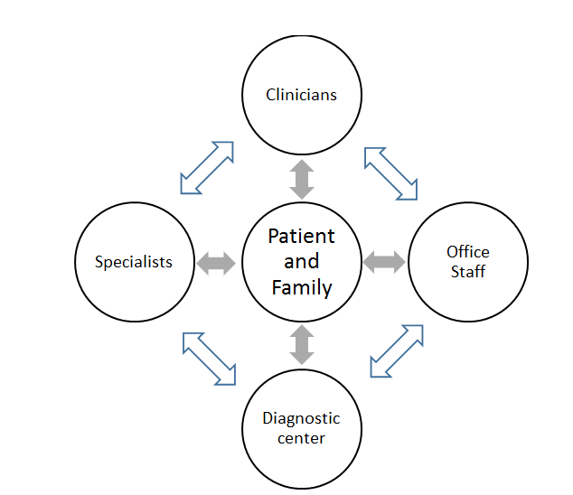
Communications that can Lead to Safety Risk

Slide 34
Communication That Can Lead to Safety Risk
Between Clinician and Patient
Interrupting the patient, before he/she describes all their symptoms
Not encouraging patient to describe problems with adherence to prior treatment plans
Missing new information on family history
Overlooking patient concerns with new treatment plan
No communication about danger signs to watch for
Assuming correct understanding of instructions
Not acknowledging if diagnosis is uncertain
Not checking if all issues were addressed
Notes:
Interrupting the patient and not hearing all the symptoms, leads to wrong diagnosis (Osler)
Not asking about concerns with the treatment plan, patient does not follow through
Not assuring correct understanding of instructions – unclear explanation, or just asking “ do you have any questions”
Not acknowledging uncertainty about diagnosis and explain the expected outcome and need for the patient to call and let the office know
Incomplete communication about danger signs to watch for with new medications, what to do
Didn’t check to see that all health issues were raised and discussed, left a problem unaddressed

Slide 35
Communication That Can Lead to Safety Risk
Between Practice Staff and Patient
Front desk staff didn’t collect information to assess urgency of need
Staff didn’t check with patient - plans for “next steps”
  Does patient understand what to do next?
  Are there barriers or concerns?
Asking “ yes or no” instead of open-ended questions – checking if patients had all their questions answered

Slide 36
Communication That Can Lead to Safety Risk
Between staff within the practice
Poor communication of patient concerns, changes in condition or medications
Not having staff meetings/using huddles/other reliable strategy to share a condition that is a risk for the day
“Hand-Offs” - Communication between staff across different offices
Inadequate communication of urgency for referrals or tests
No communication of specialist visit “no shows” to referring clinician

Slide 37
“Safety Eyes” lead to Improvement
Once you’ve identified risks – defects in your process
you can use the Model for Improvement and small tests of change
to protect your patients by solving the problem once and for all

Slide 38
Patient Engagement
Clinical Relationship | Practice Improvement
Involve patients in their own care | Patients help identify problems, design and test improvements

Slide 39
Patient engagement is a key lever for improvement
Researchers at Academic Innovations Collaborative (Center for Primary Care, Harvard Medical School) working with primary care practices found:
  Teams were very reluctant
  Patient involvement surpassed expectations
  Putting patient on the team was critical step
* Singer, Sara J. PhD MBA, Principal Investigator, Harvard Chan, HMS, MGH, Presentation to the MA Coalition, September 29, 2016

Slide 40
Engaging Patients
How do we engage patients in this work?
Patients’ perspective – identifying defects
Patients’ suggestions for improvements
Patients’ reaction to changes tested
Patients on your improvement team
“The greatest asset we have underutilized is
all the assets of the patient.”
Maureen Bisognano, President and CEO
Institute for Healthcare Improvement

Slide 41
Not just one patient
There is no ‘representative’ patient
More effective strategies
  Involve multiple patients
  Engage in multiple ways
    Focus groups
    Surveyed patients
    Encouraged input on the portal
    Other ideas

Slide 42
Making Patient Engagement Effective
Patients are often unwilling to criticize!
“Culture of low expectations” – don’t expect much
Select “constructively discontented” patients and family members to involve
Script to encourage input – what topics, reaction to test
  “ We are working on improving X, it would really help us if you tell us what would make this better”

Slide 43
Discussion
How could you engage patients
in identifying safety risks?
Notes:
We are all patients. As a patient, have you ever been asked if you’ve experienced safety issues?

Slide 44
Summary
Patient Safety thrives in a culture where system issues are pursued as the root cause; not a culture of “blame” or relying on “heroes”.
Communication is the underpinning of many patient safety issues. Engaging patients in improvement reaps benefits that surpasses expectations.
See Problem, Solve Problems –Work with frontline staff, patients and your improvement teams to solve problems instead of putting out the same fires.
Say “Thank you!!” when patient safety problems are brought to you.

Slide 45
Strategies for Patient Safety
Goal: Nothing in the process of care (or omitted during care) contributes to harm to the patient
  “Safety Eyes” - looking at daily work for safety problems
  Starting meetings/huddles with a question about safety concerns –
    “What keeps you up at night?”
    “What have you seen that you worry could harm a patient?”
  Asking patients for their ideas/worries
  Keeping a “Glitch List” - processes that need improvement
  Using the Model for improvement and Plan-Do-Study-Act cycles for continuous improvement
Test: Have we improved the process so the patient is safe yet?

Slide 46

Using the Model For Improvement (MFI) Framework
Answer what are we improving, how much, by when.
To increase/decrease XXX by ZZ% by YY date.
Sample measurement
Number of XXX (numerator)
Total number of XXX (denominator)
Team to provide test ideas.
PDSA =
The PDSA form can be used when you get here
Developed by: Associates in Process Improvement
Notes:
Need to know baseline before you can increase or decrease by xx%

Slide 47
The three MFI Questions
MFI questions | Sample answers
1. What are we trying to accomplish? | Aim Statement – Our current rate of closing the loop with FOBTs is 33% within 15 business days. Our Aim is to close 90% within 15 business days by 6/30/xxxx.
2. How will we know that a change is an improvement? | Measurement Number of FOBTs returned within 15 business days/Number of FOBTs given out (per day)
3. What changes can we make that will result in an improvement? | Team to provide test ideas.
Notes:
“Some is not a number.”
“Soon is not a time.”
“Hope is not a plan.”

Slide 48
Using Flow Mapping to Focus: Visualize the Steps
High level (work) flow diagram
3 to 5 Steps-keep it simple
Identify defects - problems that hinder the process
  Is there a cascade?
  Which is the biggest defect?
  Identify what you will fix – What change can you test?

Slide 49
High Level Flow Chart
How is the process supposed to work?
How does it really works? Where do things fall apart?
i.e. Diagnose Order test or referral
Patient receives follow-up
Some action that starts the process. Can start with a verb.

Slide 50
Why do things fall apart?
Tool: Ask “Why?” Five Times
Curiosity!
To help you understand the underlying reasons why your process does always work.
Why?
Why?
Why?
Why?
Why?
Notes:
Is the defect not completing the step? We want to make clear that looking for defects/problems is more than just missing a step? (ie. someone is administering the vaccine but not reliably the correct vaccine)

Slide 51
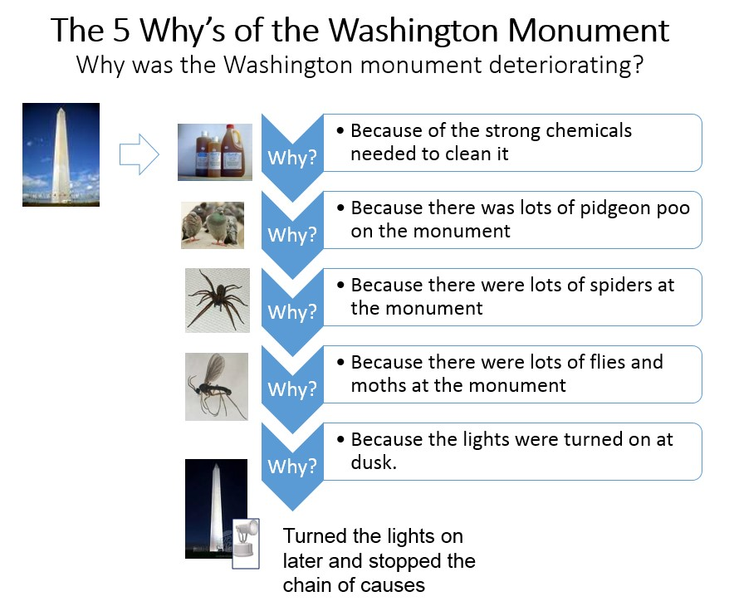
Source: http://www.rch.org.au/uploadedImages/Main/Content/quality/Washington%20Monument.jpg
Our thanks to Sue Butts Dion
Notes:
Example of exercise to help determine root cause.
(Can give example of something from their unit.)

Slide 52
What might improve this step?
What change do we want to test?
A good test idea answers a hypothesis.
  Hypothesis – if we send a patient letter explaining why a diabetic eye exam is so important, an educated patient would be more likely to complete the eye exam.
        Test – Send letter to diabetic patient population with clearly stated reasons why eye exams are necessary, and give names/locations/times of eye exam providers.
        Task – Write draft letter.
        Task – show draft letter to select patients to get feed-back
        .
Allows you to answer y/n to hypothesis
Makes the test possible

Slide 53
Test on a Small Scale
  What can you do by Tuesday? What can you by this afternoon?
  “The Power of One” – one patient, one clinician, one visit

Slide 54
IHI Videos
(3-4 minutes each)
Using the Model for Improvement (Parts 1 & 2)
http://www.ihi.org/education/IHIOpenSchool/resources/Pages/AudioandVideo/Whiteboard3.aspx
http://www.ihi.org/education/IHIOpenSchool/resources/Pages/AudioandVideo/Whiteboard4.aspx
Plan, Do, Study, Act (PDSA) Cycles to Test Changes (Parts 1 & 2)
http://www.ihi.org/education/IHIOpenSchool/resources/Pages/AudioandVideo/Whiteboard5.aspx
http://www.ihi.org/education/IHIOpenSchool/resources/Pages/AudioandVideo/Whiteboard6.aspx

Slide 55
Process Improvement Check List
Getting Started
Select a Patient Safety topic to solve
Ask- What keeps you up at night? Ask your patients
Getting Started
Don’t boil the ocean
Ask – Can we narrow the scope? Not all referrals, not all test follow-up, not all patients.
Getting Started
Assemble a Team
Ask – Who are the front-line staff?
Ask – How can we get patient feedback?
Hint – Keep a list on a “parking lot”. Use a “glitch book” to keep track of ideas.
Notes:
Example – delayed and missing results at Marino frustrates everyone and creates patient dissatisfaction. The risk of missing something critical is high for many of the labs. Specialty reference tests are the worst but all labs are impacted.
Input from all levels of staff indicated that staff at every level as well as providers and patients spent time following up on specialty labs and would benefit from an improved process. We had an inconsistent process but patient education and following up on delays were identified as the two biggest opportunities.
To keep the project simple and manageable we agreed that patient education was the biggest opportunity for improvement. The biggest barrier was delays in testing due to misinterpretation of test requirements. We decided to focus on that and standardize tracking as part of the process.
Once this was decided the AIM statement followed. We will close the loop on 90% of our specialty lab tests within 30 business days.

Slide 56
Process Improvement Check List
Getting Started
Get some baseline data
Ask – What is happening now?
Getting started
Write an Aim Statement
Ask – Now that we have a baseline, what do we measure so we know how much to improve by when?
Clarify Refine
Narrow the focus of the Aim Statement
Ask – Can we narrow the scope? Not all referrals, not all test follow-up, not all patients
Hint – When you have a good Aim Statement, you know what to measure.
Hint – Don’t get stuck here. Just enough data, one day’s; one week’s. Extrapolate from there.
Notes:
Example – delayed and missing results at Marino frustrates everyone and creates patient dissatisfaction. The risk of missing something critical is high for many of the labs. Specialty reference tests are the worst but all labs are impacted.
Input from all levels of staff indicated that staff at every level as well as providers and patients spent time following up on specialty labs and would benefit from an improved process. We had an inconsistent process but patient education and following up on delays were identified as the two biggest opportunities.
To keep the project simple and manageable we agreed that patient education was the biggest opportunity for improvement. The biggest barrier was delays in testing due to misinterpretation of test requirements. We decided to focus on that and standardize tracking as part of the process.
Once this was decided the AIM statement followed. We will close the loop on 90% of our specialty lab tests within 30 business days.

Slide 57
Process Improvement Check List
Clarify Refine
Ask – What are the 3-5 Primary Drivers to achieve our Aim? What are the 2-3 Secondary Drivers that create each Primary Driver? Can your patients contribute to this process?
Clarify Refine
Flow Chart
Ask – How is this process supposed to work? What are the 5 – 7 steps?
Clarify Refine
Test Ideas
Ask – What change do we want to test? What can we try by next Tuesday? Can it be tested with 1 provider/1 patient? Tested with 1 referral etc.?
Hint – Frontline staff have the best Test Ideas. Do your patients have ideas?
Hint – Don’t go over 5 Primary Drivers. It’ll just get too complicated. This is an iterative process. You may modify the Driver Diagram over time.
Hint – Last step is always Patient receives appropriate follow-up.
Driver Diagram
Ask – Where are the weaknesses? Where could something go wrong?
Notes:
Example – delayed and missing results at Marino frustrates everyone and creates patient dissatisfaction. The risk of missing something critical is high for many of the labs. Specialty reference tests are the worst but all labs are impacted.
Input from all levels of staff indicated that staff at every level as well as providers and patients spent time following up on specialty labs and would benefit from an improved process. We had an inconsistent process but patient education and following up on delays were identified as the two biggest opportunities.
To keep the project simple and manageable we agreed that patient education was the biggest opportunity for improvement. The biggest barrier was delays in testing due to misinterpretation of test requirements. We decided to focus on that and standardize tracking as part of the process.
Once this was decided the AIM statement followed. We will close the loop on 90% of our specialty lab tests within 30 business days.

Slide 58
Process Improvement Check List
PDSA
Hint – The hypothesis asks if we do X will Y happen?
PDSA
Use the PDSA form as a check list
Ask – Who is doing what when? Who is collecting the data?
PDSA
Test versus Task
Test – Provides an answer to the hypothesis.
Task – Doing something that makes the Test possible; write a letter, get feedback from a patient etc.
Hint – Don’t collect a lot of data.
Hypothesis
Hint – Test small. Fail Fast, Fail Often!
Ask – What is your prediction?
Notes:
Example – delayed and missing results at Marino frustrates everyone and creates patient dissatisfaction. The risk of missing something critical is high for many of the labs. Specialty reference tests are the worst but all labs are impacted.
Input from all levels of staff indicated that staff at every level as well as providers and patients spent time following up on specialty labs and would benefit from an improved process. We had an inconsistent process but patient education and following up on delays were identified as the two biggest opportunities.
To keep the project simple and manageable we agreed that patient education was the biggest opportunity for improvement. The biggest barrier was delays in testing due to misinterpretation of test requirements. We decided to focus on that and standardize tracking as part of the process.
Once this was decided the AIM statement followed. We will close the loop on 90% of our specialty lab tests within 30 business days.

Slide 59
Process Improvement Check List
PDSA
Sustain
Run Charts
Display run chart in break room. Start staff meetings with Pt Safety question.
Spread
Share your stories
Other practices could learn from your journey. Share your successes, failures and surprises.
Adopt, Adapt, Abandon
Ask – Is this a system change or are we relying on people’s good intentions?
Hint – Patient stories are powerful!
Ask – Did we achieve the outcome we wanted? What do your patients think?
Ask – If not, can we tweak the change? Test something else? Does this process work on weekends or when X is out? Is there a back-up plan?
Ask – What else can we solve? Go look at the “parking lot” for ideas!
Celebrate!
Notes:
Example – delayed and missing results at Marino frustrates everyone and creates patient dissatisfaction. The risk of missing something critical is high for many of the labs. Specialty reference tests are the worst but all labs are impacted.
Input from all levels of staff indicated that staff at every level as well as providers and patients spent time following up on specialty labs and would benefit from an improved process. We had an inconsistent process but patient education and following up on delays were identified as the two biggest opportunities.
To keep the project simple and manageable we agreed that patient education was the biggest opportunity for improvement. The biggest barrier was delays in testing due to misinterpretation of test requirements. We decided to focus on that and standardize tracking as part of the process.
Once this was decided the AIM statement followed. We will close the loop on 90% of our specialty lab tests within 30 business days.

Slide 60
Example of PI Project selection
Let’s fix the referral process
Let’s fix the GI referral process
Let’s fix the colonoscopy referral process
Let’s fix the routine colonoscopy referral process
Let’s fix the routine colonoscopy referral process between 1 PCP and 1 GI doc

Slide 61
Measurement
You know you have a clear Aim Statement when it is easy to identify what to measure.
  Increase Diabetic Eye exams from baseline of 30% to 75% by 12/31/2016.
Rapid small tests to check if idea works or not. Fail often, Fail fast.
A fun TED Talk on celebrating failure: https://www.ted.com/talks/astro_teller_the_unexpected_benefit_of_celebrating_failure
This is where you
get your denominator
Use this to figure out your numerator

Slide 62
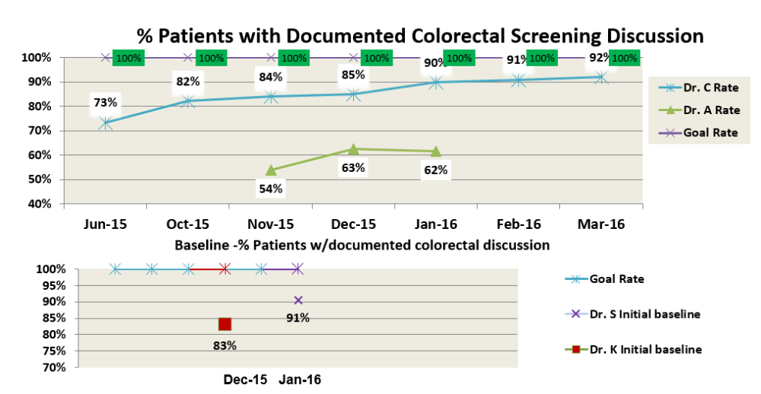
Sample Run Chart

Slide 63
Hierarchy of Sustaining Change
Weakest
Policies,
training,
inspection
ASK: does the change depend on well meaning person or well designed system?
Minimize
consequences of errors
Make errors visible
Make it easy to do the right thing
Make it hard to do the wrong thing
Eliminate opportunity for error
Strongest
Standardization & Simplification
Doug Bonacum, Kaiser Permanente

Slide 64
Improving - Tricks of the Trade
Don’t drive yourself crazy with work-arounds
  Test small – very small – one patient/one hour
  See what happens - measure
  Test again, measure again
  Implement change – or if it fails try something else
  Celebrate and share success

Slide 65
Appendix – Tools & Resources
Patient Engagement Improvement Tools
Sample PDSA Form
Blank PDSA Form
Sample Driver Diagram
Blank Driver Diagram
Videos

Slide 66
Patient Engagement Improvement Tools
Patient Question Tool: On a scale of 1 to 10, 10 being the most likely, ask -
  How important do you think it is to complete XYZ?
  How likely are you going to complete the appointment/test?
  What would make it a 10?
Teach back: ask the patient –
  “We went through quite a bit of information today. Just so I know I was clear, can you tell me how you will do this test when you get home?”
Open-ended questions

Slide 67
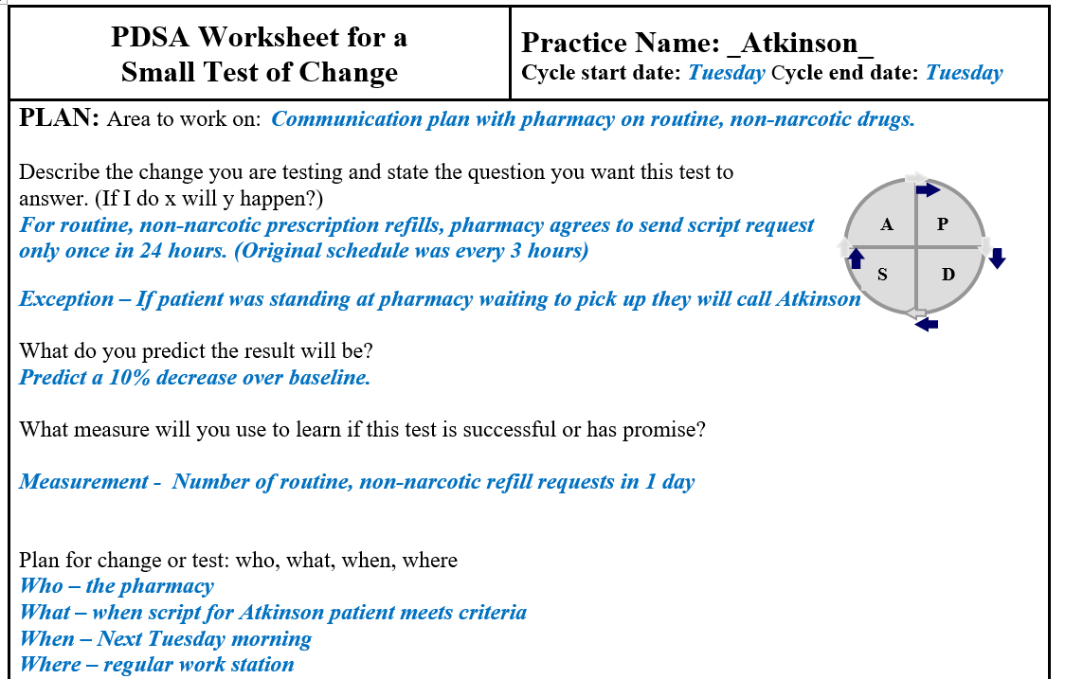
Sample PDSA Form - 1

Slide 68
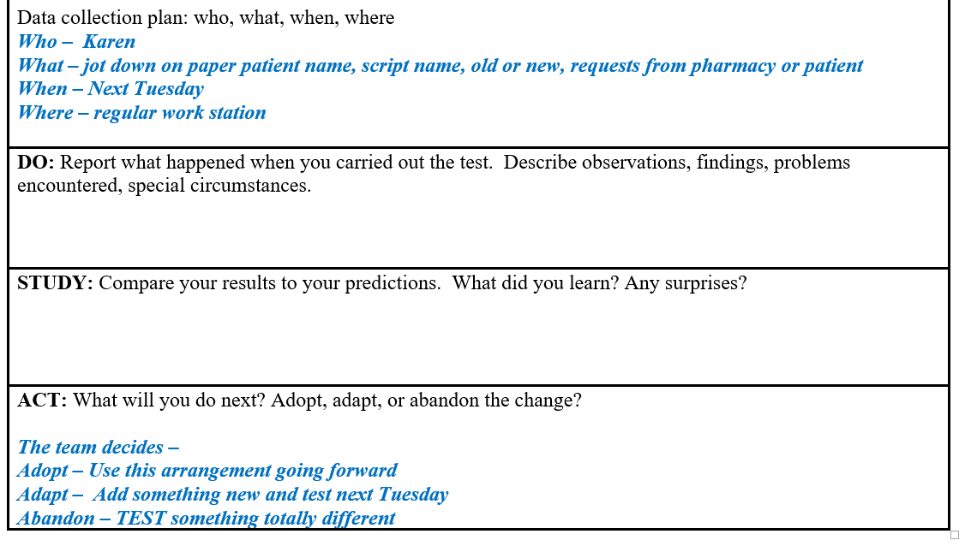
Sample PDSA Form - 2

Slide 69
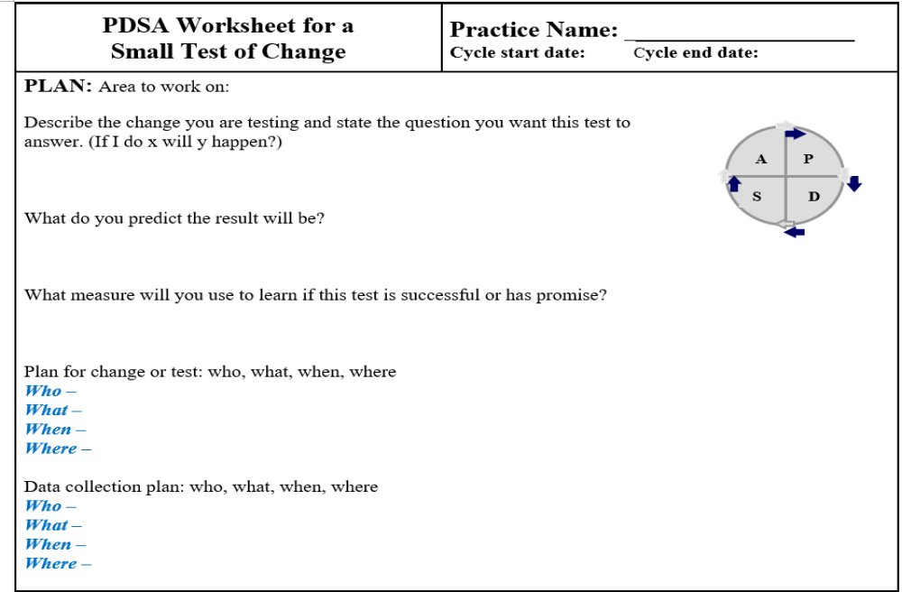
Blank PDSA Form

Slide 70
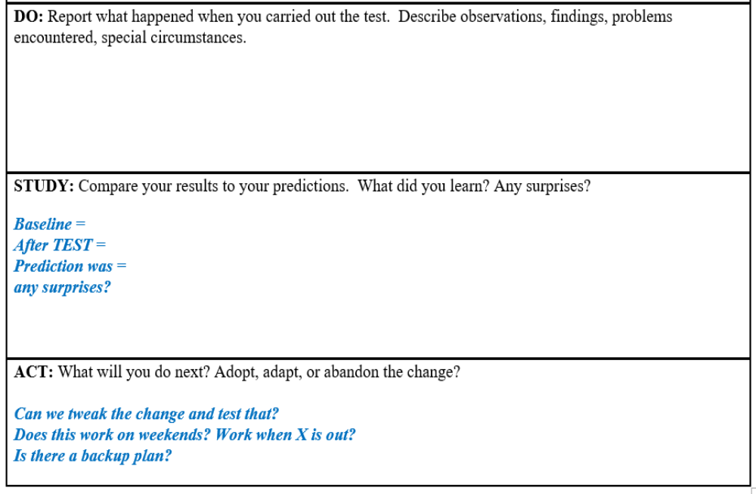
Blank PDSA Form

Slide 71
Sample Driver Diagram
Primary Drivers
Secondary Drivers
Correct diagnosis codes in EMR
Aim Statement
Correct identification of Diabetic Patients
Ran correct pt reports
Increase Diabetic Eye exams from baseline of 30% to 75% by 12/31/2016
Pt has correct info to make apptmt
Patients complete Diabetic Eye Exams
Pt understands importance of eye exam
Practice receives results
Specialist has correct practice contact info

Slide 72
Blank Driver Diagram
Secondary Drivers
Primary Driver
Secondary Drivers
Aim Statement
Secondary Drivers
Primary Driver
Secondary Drivers
Primary Driver
Secondary Drivers
PRIMARY – Key contributors to desired outcome. Examples: Could be a concrete process step such as “Correct identification of Diabetic Patients”; could be a underlying condition in the practice/general concept such as “Leadership” or “ Patient Engagement” No more than 5.
SECONDARY – Factors that influence Primary Drivers. 1 to 3 Secondary Drivers per Primary Driver.
IHI Video on how to use Driver Diagrams
https://www.youtube.com/watch?v=yfcE_Q-IRFg&feature=youtu.be

Slide 73
Videos
The importance of listening well -
  https://www.ted.com/talks/ernesto_sirolli_want_to_help_someone_shut_up_and_listen
Making Toast! Or how to do flow charts –
  https://www.ted.com/talks/tom_wujec_got_a_wicked_problem_first_tell_me_how_you_make_toast#t-37362
Celebrating failure –
  https://www.ted.com/talks/astro_teller_the_unexpected_benefit_of_celebrating_failure
IHI Video on Driver Diagrams –
  https://www.youtube.com/watch?v=yfcE_Q-IRFg

