Slide 1
Appropriate Evaluation and Treatment of UTI in the Elderly:
Walking the Talk
Marcia Astuto, RN
Nurse educator / Infection control nurse
William B. Rice Eventide Home
MAstuto@eventidehome.org
Susanne Salem-Schatz, Sc.D.
Program Director
Appropriate Evaluation and Treatment of UTI in the Elderly
MA Coalition for the Prevention of Medical Errors
sss@hcqi.com

Slide 2
It starts with the team
Collaborative
Mass. Department of Public Health ($ and data support)
MA Coalition for the Prevention of Medical Errors
Mass. Senior Care
Consultants in organizational change, geriatrics /infection prevention and infectious disease
On the front lines
All Unit Managers
Nursing Supervisor
Director of Social Services
Infection Control Nurse/Nurse Educator
Support Team
Medical Director
Director of Nursing
Executive Director

Slide 3
Frameworks for Improvement: QI
Collaborative
Taught the Model for Improvement: focus on aims, measures, small tests of change
Regular review collaborative data and progress to evaluate our own work and modify plan as needed.
On the front lines
Old Way: When an Eventide Resident presented with possible UTI symptoms, obtain a UA C&S.
New skills required: COURAGE
PDSA #1: Develop, utilize new assessment.
Study: No ill effect. NO ANTIBIOTICS.
Positive outcome for the Resident.
Act: Share this outcome with other units.
Spread to other units.
Tools: Use Root Cause Analysis prn.

Slide 4
Frameworks for Improvement:
Front line engagement
Collaborative
Didactic and experiential instruction on engagement strategies
Learning and sharing calls & one-to-one coaching calls to keep the work front and center.
On the front lines
Monthly Data display increases opportunity for learning
High traffic areas
Promotes healthy competition
Quarterly Infection Control results
Reinforce and Educate
Medical Director → NPs, PCPs
Social Services → Psych Consults
  Changes in mental status, behaviors
1:1 education prn for engagement
Visibility, Transparency

Slide 5
The right tools for the job
Collaborative
Purposeful design of overall collaborative and events based on context and specifics of the change.
Focus on engagement & persuasive communication
UA C&S Ordered
Does Resident Meet Criteria? Yes or No
If Yes, Proceed with Order
If No, Communicate why order was cancelled.
Ordering MD
New NP
Consulting MD
Covering MD
Family
New Process Flow with Criteria
“Choosing Wisely”, AMDA poster in high traffic areas

Slide 6
Make the right thing the easy thing
Collaborative
Created multiple and redundant opportunities for learning
Created tools to facilitate practice change using principles of behavior change
Target nursing practice, prescriber decision making, resident/family awareness
On the front lines
ABC Tool has become protocol ; Introduced at Staff Orientation
New Resident Admission is a time of significant adjustment
Admission Packet has 100 pages
Decision made to delay teaching of evidence-based UTI materials until later in Resident’s 1st week:
  1:1 teaching by Infection Control Nurse
  Enables deeper engagement
  Include families as appropriate
  Further follow-up as needed
  (e.g., Medical Director reinforces Protocol )

Slide 7
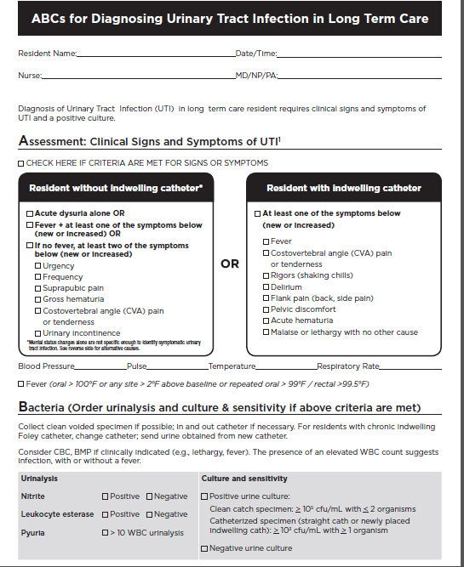
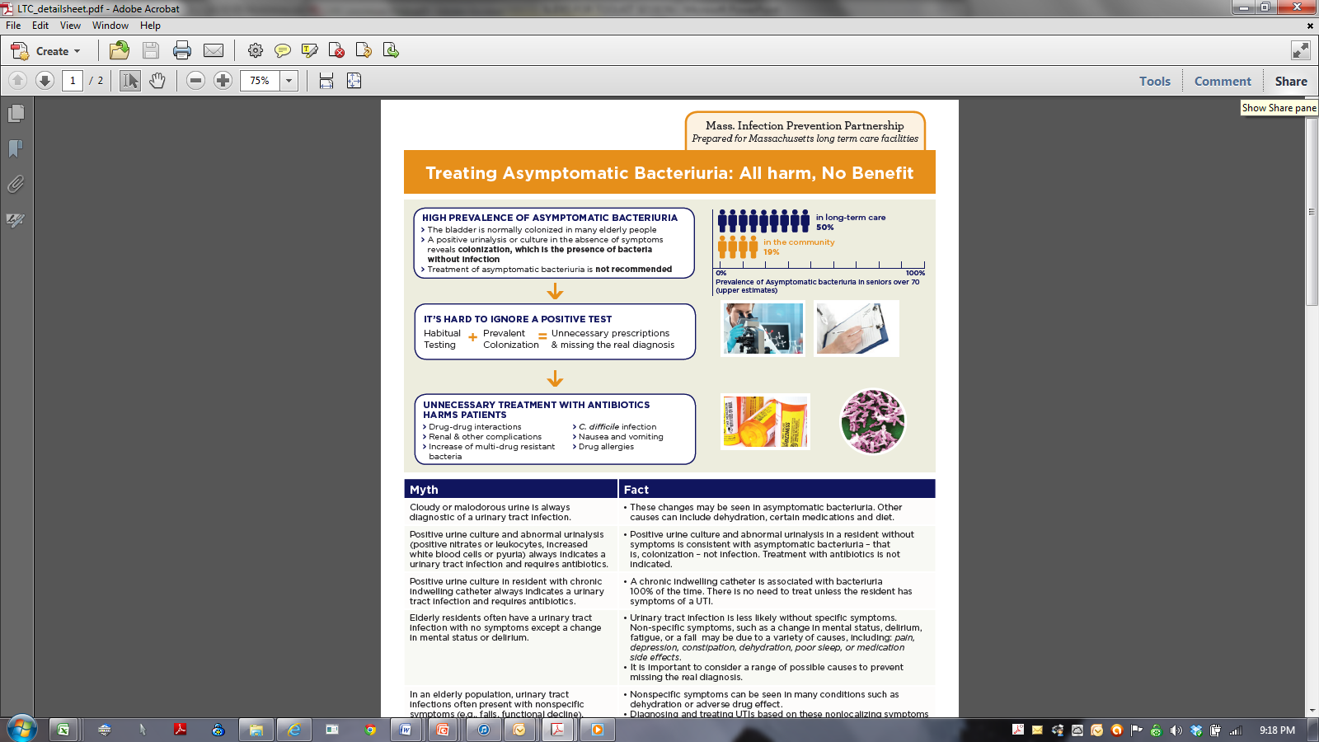

Slide 8
How do we know a change is an improvement?
Collaborative-wide 2012-2013
Collaborative
Track participation and outcomes
28% decrease in urine cultures
33% reduction in reported UTIs;
45% reduction in healthcare acquired C. difficile

Slide 9
How do we know a change is an improvement?
Eventide 1/2013-2/2014
On the front lines
Quarterly QA hospital Microbiology report now posted
Reviewed monthly with Medical Director
Casper Report (quality measures) shows Eventide infection control rate is well below both the national and state %:
Based on the last period
Our Facility observed rate is 1.6%
State average is 5.7%
National average 6.4%
The results tell the story
% of UTIs meeting appropriateness criteria
First 6 months - 0%
Past 9 months - 75%

Slide 10
Signs of progress but still hard at work

Slide 11
AMBULATORY MEDICATION RECONCILIATION AND SAFETY CONCERNS
Massachusetts Coalition for the Prevention of Medical Errors
2014 Patient Safety Forum
April 7, 2014
Christopher M. Coley, MD
Patricia C. McCarthy, PA, MHA
Massachusetts General Hospital
v7.0

Slide 12
Presentation Objective and Overview of Problems
Objectives:
Review the opportunities for improving medication safety through an outpatient medication reconciliation program
Discuss potential risks introduced by the program and challenges posed by competing regulatory requirements
Challenges and Drivers :
Ambulatory settings: Lower number of reported safety events but the chance of error may be greater due to:
  The complexity of the outpatient workflow processes
  Multiple prescribers in different settings
  Lack of integration of electronic medical records
  Limited and sometimes ambiguous institutional policies
  Unclear role definitions for clinicians who manage medications
  High variation in the integration of the patient as a partner in the process
  High variation in patient sophistication and awareness of the risks
Patient safety efforts, Joint Commission, Meaningful Use, ACO, and others – Require med rec but alignment of individual regulations is not optimal
Current regulatory expectations for “routine” Medication Reconciliation may reduce the risk of medication errors while introducing new risks

Slide 13
MGH/MGPO Approach
Medication reconciliation is the process of:
Documenting an accurate medication list of meds that the patient is/should be taking
Evaluating the medication list in the context of the patient’s care
Providing a current list of reconciled medications to the patient
Explaining the medication list to the patient and advising them to share the list with providers
We built on prior inpatient experience including defining general roles and responsibilities, involving MDs, RNs, PHS and others in the process
Attempted to align/address expectations where possible
Developed consensus-driven policies and collaboratively developed workflow best practices (e.g. use of pre-visit form for patient to review)
Rolled out to all practices and providers at the same time
Coordinated roll-out of the policy and electronic enhancements
Met with leadership groups, individual practices, individual providers when necessary (Practice Support Unit successfully coordinated efforts)
Key driver was patient safety but Joint Commission requirements, Meaningful Use incentives, senior leadership support used as leverage to generate interest
Provided reports at the practice and provider level, ability to audit electronically was essential
Incentivized providers to improve (QI Incentive Program)

Slide 14
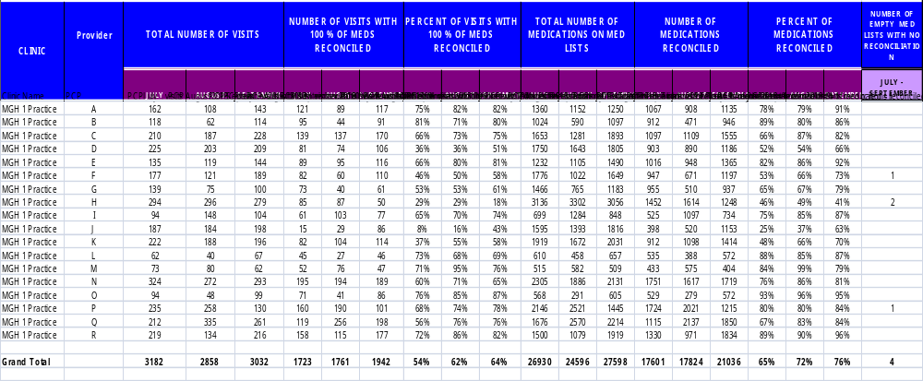
Example of Report for One PCP Practice
MEDICATION RECONCILIATION IN OUTPATIENT SETTINGS - EMR - PCP REPORT
JULY, AUGUST & SEPTEMBER 2013
Specialists were given an additional measure: % of visits where at least one medication was reconciled
Addressed Meaningful Use requirements and encouraged performing med reconciliation routinely

Slide 15
Performance
 | % of Visits with at Least One Medication Reconciled |  |  | % of Visits with 100% of Medications Reconciled
 | March-12 | September-13 |  | March-12 | September-13
PCP | NA | NA |  | 24% | 64%
Specialists | 37% | 58% |  | 11% | 34%
Feedback suggests that the lists have gotten better and that it takes less time to reconcile at each visit
Specialists, patients and support staff have taken on larger roles in the process
Sharing med lists at the end of the visit with the patient (paper or electronic portals) encouraged providers to improve accuracy
Measures were based on general concept that PCPs were responsible for entire list, specialists for medications that impacted their scope of practice (but for QI Incentive Program Meaningful Use minimum used)
Concern:
Needed time and experience to determine impact of initial efforts before more clearly delineating specific responsibilities due to concern that everyone may not have same ability to reconcile accurately

Slide 16
Lessons Learned
Pitfalls of large process changes implemented quickly based on unclear, potentially misaligned regulatory expectations include:
  Providers were unsure of the expectations and their roles
  Literal interpretation of regulations may lead to reflexive editing of the EMR med list by non MD staff or physicians not familiar with a given medication and not responsible for the area of clinical expertise
  Support staff may help reduce burden on providers but staff may not have adequate training currently
  Underlying problems are now more obvious (med lists in two applications that do not match)
  **Increase in number of complaints from patients when they see their med lists are inaccurate - needed systems to effectively deal with the complaints and make needed changes
  Risk increases when making changes across large organizations with different electronic applications, definition of roles and institutional policies (e.g multiple EMRs contribute to the challenge of building and maintaining accurate medication lists)

Slide 17
Challenges Related to Regulatory Requirements
  Good concepts but need to be implemented incrementally
    Requirements may not always take into account the challenges involved in operational changes and may force practices that are not safe.
    e.g. requirement that all prescribers provide an updated medication list to a patient at the end of the visit even when the prescriber is not sure that the list is accurate
  Broad concepts that require interpretation and tailoring to specific settings/providers
    Requiring all prescribers to have the same level of accountability for updating medication lists may not be reasonable
    Errors occur when people who are not familiar with specific meds make changes based on patient input alone
    Specialists are often uncomfortable being ‘responsible’ for attesting to medications outside their area of expertise.

Slide 18
Take Aways
Effective and safe solutions involve:
  Need to balance the desire to immediately address compliance with regulations with the need to ensure patient safety
Understanding of the tradeoffs between efficient, standardized process for all providers vs. varied expectations that allow the appropriate clincians to manage the medications with assistance of trained support staff
Need to clearly define system-wide policies, roles and responsibilities that are appropriate to the clinical care setting and provider area of expertise
Support staff need to receive additional training if they are to take on new responsiblities in Med Rec – will require time and resources
  Meaningful, consistent patient engagement and involvement through the use of patient portals will be key to the success of any medication reconciliation program.
  Practice-based or central resources to collect/document medication information may help improve quality and reduce risk and workload for providers
  New electronic sources of medication information may be more integrated into system and improve accuracy of the lists (SureScripts)
  Ultimately, a single medication list for each patient across the continuum of their care will help to address some of these concerns

Slide 19

Partnering with Patients: Leveraging Transparency to Improve Safety
The Patient TIPS and
OpenNotes Reporting Tool models
Sigall K. Bell, MD
Arnold P. Gold Professorship, Beth Israel Deaconess Medical Center
Director, Patient Safety and Quality Initiatives, Institute for Professionalism and Ethical Practice, Boston Children’s Hospital
Harvard Medical School
With generous support from:
The Schwartz Center
CRICO/RMF
Notes:
Delighted to be here

Slide 20
Leveraging transparency to improve patient safety
Patient Teachers in Patient Safety
OpenNotes Patient Reporting Tool
“Nothing about me without me”
Notes:
Today id like to tell you about 2 initiatives that try to leverage this transparency to improve patient safety
TIPS
OpenNotes reporting tool

Slide 21
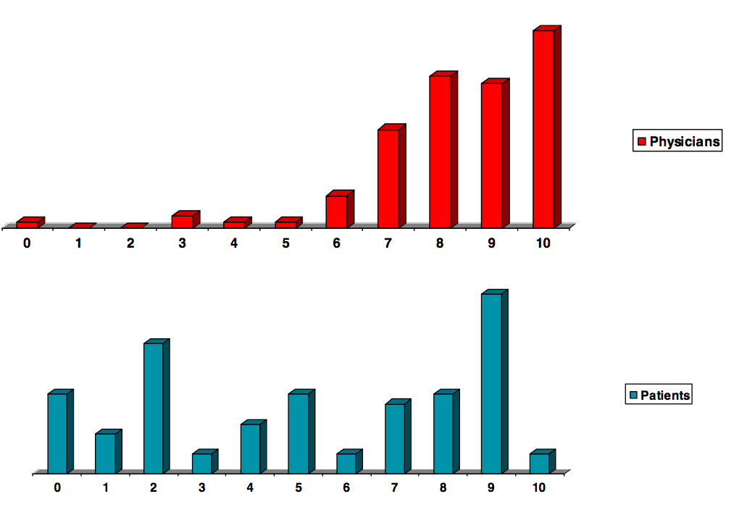
I. Patient Teachers in Patient Safety: Background
Experts and advocates recommend involving patients/families in safety efforts, but robust partnerships are few
Patients/families and clinicians experience disclosure differently
Can we close the gap?
Can we empower speaking up?
Pilot data, COPIC; Gallagher JAMA 2009
Notes:
Lets start with pt tips. Rationale was 2 core principles: first,… and second, we kmow…
So if younask over 1000 pts and doctors to evaluate disclosure as they did in the copic program… remember, the same conversation… you can see that while doctors think things are going pretty well, about half of patients and family are rating those conversations as a 5 or lower. So we wondered: can we close this gap – first by understanding the differences, and then by aligning pt and clin perspectives…
Patients are the expert witnesses of our care
837 events
445 patient surveys (55% response rate)
705 physician surveys (84% response rate)

Slide 22
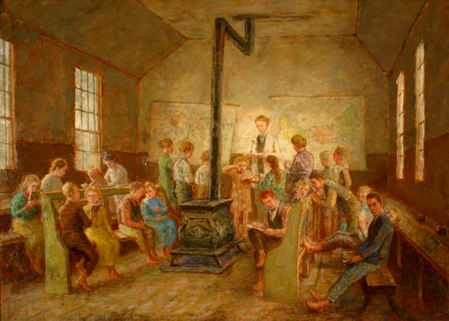
What is Patient TIPS?
A new paradigm: Bring patients/family into medical error disclosure and prevention training sessions
Interprofessional clinicians
“One room schoolhouse” – deconstructed hierarchy
Pedagogy:
  Live simulations
  Video trigger clips
  Case vignettes including speaking up
  Integrating clinician and patient views
Assessment: Pre/post surveys (53/55 (96%) clin; 71/88 (81%) pts)
“One room schoolhouse”
Robert Harris, 19th century
Funded by the Schwartz Center
Notes:
So we built the tips model using a new paradigm: why not invite pts/fam right into… discl and prevention training alongside interprof participants in a one room schoolhouse that
dissolves traditional barriers, vertical and horizontal hierarchies.. honoring the jap proverb… none of us is as smart as all of us
Pedagogy
Enactment: in this case a medical error disclosure conversation.
All the while, integ pt and provider views in the discussion
Model: now adding…
Surveys – starting with a 96% rr from volunteering participating clin and 81% of patients from PfACs at 2 diff hospital systems.

Slide 23
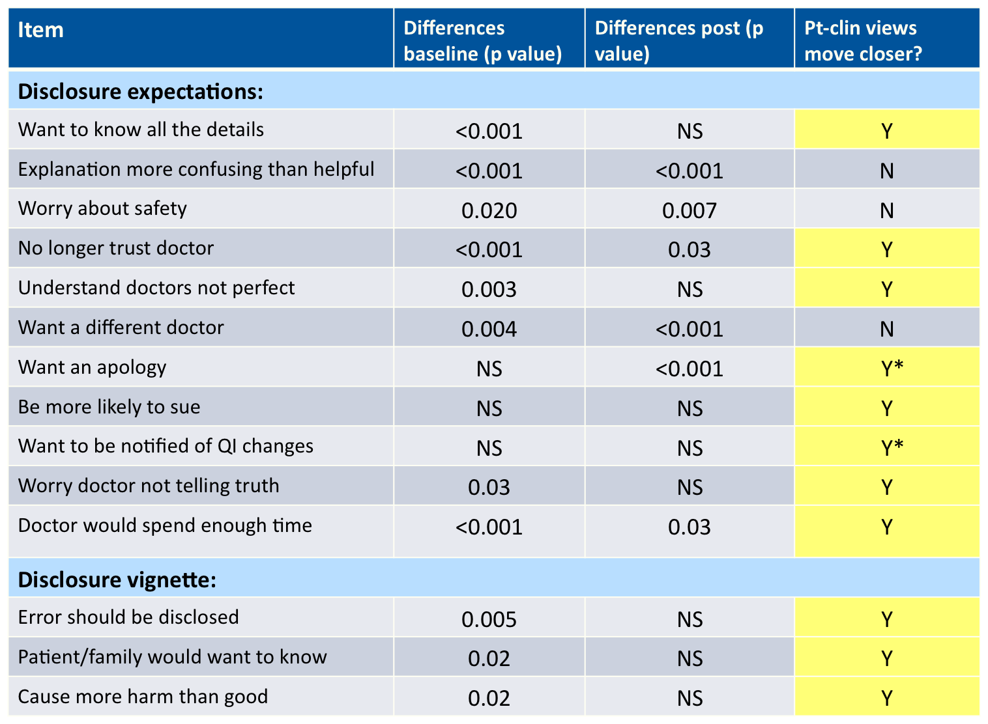
Notes:
So here’s what we found. At baseline there were indeed significant differences bet pt and provider views in the great majority of disclosure expectations– 72% cotagories. Given a medical error vignette, there were also sig differences in all the disclosure questions – should be, want to know, harm than good…
After the training, we found far fewer differences, and pts and clin moved closer together in their views in the marjority of categories, in some cases with providers endorsing even more transparency than patients

Slide 24
Conclusions and Take-homes
The model is feasible and effective:
  100% patients, 84% clinicians felt comfortable discussing errors
  96% clinicians reported patient/family participation was valuable to their learning
  3-month follow-up: 79% clinicians report more collaborative patient interactions; 100% patients reported the same
Collaborative learning enhances concordance of views:
  Even with motivated volunteer clinicians, important differences in baseline perspectives, and patient/provider views come closer together
  “[I learned about] the collective wisdom of ‘us,’ and the ‘us’ includes patients.” – A nurse
  “The program provides a “perspective that we don’t usually get. I don’t really know what patients are really feeling.” -- A Physician Assistant
  “My perspective regarding my role as a patient has also shifted and I no longer see myself as the recipient of care but rather an equal partner in my care. –A patient
Notes:
Some conclusions. The model is feasible. basiclaly put everyone in a room and said now we’re going to talk about mistakes… and it worked. 100%pts, 84% clin completing the program felt comfortable…
96% reported that including pts/fam was valuable
At 3-month follow-up, 79% of clinicians stated workshop participation helped make their patient interactions more collaborative; 100% patients reported the same about clinicians.
Collab learning enhances concordance. As I showed you, even with motivated… important differences.. Program helps to bring views closer together
Participant take homes:
Perhaps personally most rewarding. I thought you’d never see the downstream effects in the study period – simply too short. But patients came up to me, after just one workshop and told me about ways they spoke up, in their doctor visits, often with important safety concerns and information. Blown away that a single intervention could have a positive impact at the care interface.

Slide 25
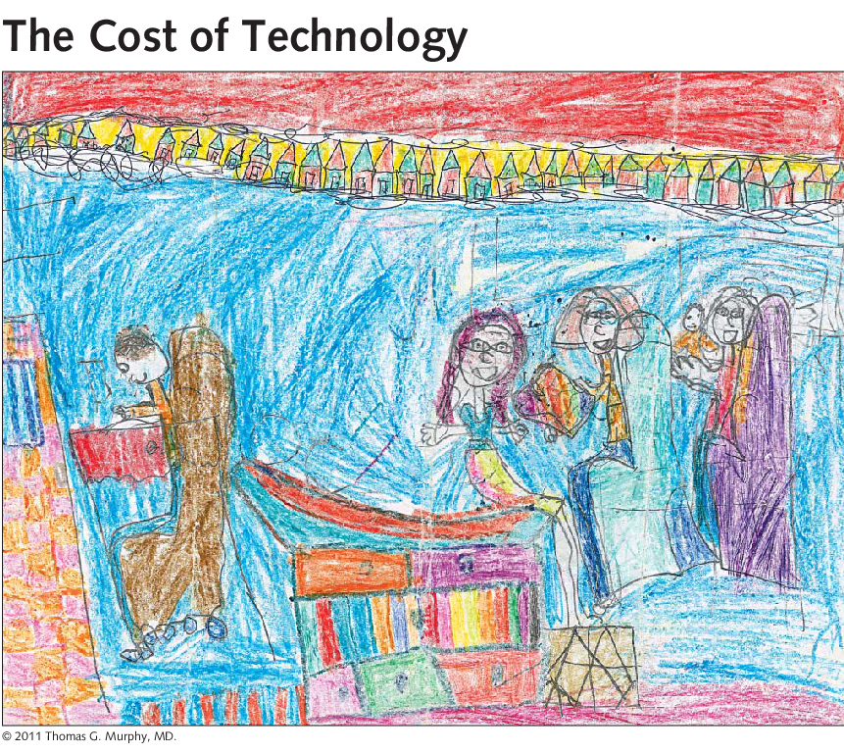
II. OpenNotes: What can we learn from patients?
Toll, JAMA 2012
Notes:
So I think there is a lot we can learn from patients. Let me continue that discussion, Switching gears to a second initiative; opennotes. Perhaps you saw this drawing, by a 7yo girl, published recently in Jama, depicting her visit to the doctor. Here she is, her sister, her mom and sib, and here’s the doctor, with his back to them all, typing on the computer. The image Strikes fear in our hearts…. This is the cost of technology as we use it now. But it doesn’t have to be this way. What about using the computer, the notes, as a way to bring pts and cliniicians together…

Slide 26

The OpenNotes experience
114 PCPs invite 20,000 patients to read their notes online
  3 sites: BIDMC Boston, GHS Danville, HMC Seattle
  Pre/Post Surveys (Quant and Qual metrics)
Patients accessed their notes
  84-92% of patients opened some or all their notes
Patients reported health benefits
  Understand their health and medical conditions better: 77-85%
  Remember the plan of care better: 76-84%
  Better prepared for visits: 69-80%
  More in control of care: 77 to 87%
  Better taking medications as prescribed: 60-78%
Doctors were not overwhelmed
  No change in email volume, little workload effect
Patients were not overwhelmed
  Notes caused confusion, worry, or offense: 1-8%
Delbanco et al, Ann Intern Med 2012
Notes:
That was the goal of the opennotes experience
In it, 114…
Focus groups and interviews: “it’s almost like there is another person there now, telling me to take my meds”… “I understand what they’re for now, so it’s easier to take them”
99% want to continue; 74-81 docs; not one turned it off. 86-89% pts would use opennotes to choose doc or HC org in future

Slide 27
Medical error/Patient safety
Delayed diagnosis: If this had been available years ago I would have had my breast cancer diagnosed earlier. A previous doctor wrote in my chart and marked the exact area but never informed me. This potentially could save lives. – A patient
Medication error: When I told her about [the wrong issues] she admitted she confused me with another pt. Also on one occasion she made a statement about increasing the dose on a medication that I never took. – A patient
Follow up adherence: Weeks after my visit, I thought, "Wasn't I supposed to look into something?“ I went online immediately. Good thing! It was a precancerous skin lesion my doctor wanted removed (I did). -- A patient
Caregivers: It really is much easier to show my family who are also my caregivers the information in the notes than to try and explain myself. I find the notes more accurate than my recollections.” -- A patient
Partnership: I felt like my care was safer, as I knew that patients would be able to update me if I didn't get it right. -- A physician
Notes:
Along the way there have been several safety anecdotes:
Close the gap between visits where amb vulnerabilities compound

Slide 28
OpenNotes as a safety strategy
Close the gap between visits?
  Remembering what happened
  Informed consent
  Med adherence
  Enhanced test/referral follow up
  More timely result notification
Implementation: rads follow up, report pathways
“More eyes on the chart” to identify errors
    One patient, one chart
    One doctor, 1000 charts
Building the patient reporting tool:
Multidisciplinary stakeholders:
  HCQ, Patient Relations, IS, HIM/Medical Records, Clinic MDs, RNs, PAs, Social Work/PFAC
  Harmonize with existing systems
Questions at end of note:
Did the note capture your story?
Did you understand the care plan?
Did you find any possible mistakes?
How was the experience of providing feedback on your notes?
QI database; provider and pt feedback
Notes:
With generous funding from crico, we are now studying the potential for opennotes as safety strategy,
With the premise that perhaps opennotes can help close the gap between visits where amb vulnerabilities compound
Everything from better remembering what happened… such a common problem, few solutions
Informed consent: our surgeons tell us in focus groups
Med adherence: pts tell us “it was almost as if there was another person there telling me to take my meds”
High risk areas: test, referral, result notification…
In fact during implementation we’ve already heard about these… woman who was reading her notes and found a pulm nodule that was supposed to be followed up
The overarching notion is that more eyes on the chart can help us, particularly given the dramatically different ratio of one pt, one chart, vs one doc, 1000 charts…
So we are now building a patient reporting tool
Harmonize existing processes
Emphasize partnership
Clinician buy in
Appreciative Inquiry

Slide 29
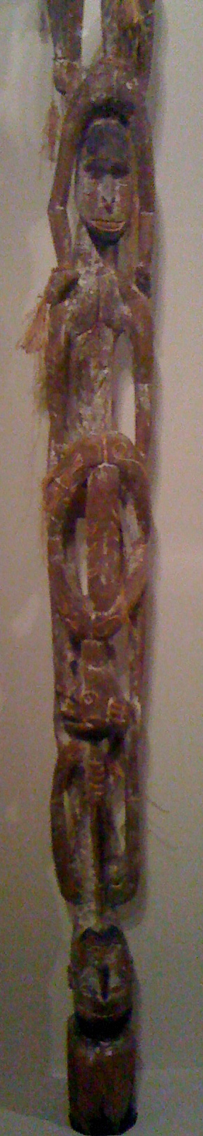
Acknowledgement
OpenNotes Team
  Roanne Mejilla
  Mary Barry
  Pat Folcarelli
  Claire Gerstein
  Amy B. Goldman
  Heidi Jay
  Susan E. Johnson
  Gila Kriegel
  Julia Lindenberg
  Larry Markson
  Elana Premack Sandler
  Kenneth Sands
  Barbara Sarnoff
  Jan Walker
  Norma Wells
  Gail Wood
  With generous support from CRICO
Patient TIPS Team:
  William Martinez
  David Browning
  Pam Varrin
  Barbara Sarnoff Lee
  Elana Premack Sandler
  BIDMC and CHA PFAC Advisors
  IPEP faculty; Allyson McCrary
  With generous support from
    the Schwartz Center
MCPME:
  Paula Griswold
  Beth Capstick
  Emily Biocchi
Notes:
So I hope I’ve tickled your imagination with some new ways to partner with patients. Let me just end with a word of thanks. Patient TIPS team, OpenNotes safety team, many people who have made extraordinary contributions… and Paul, Beth, Emily, copresenters, and I’m sure many more people working behind and in front of the scenes here at MCPME… for bringing us together to learn and improve our care
A few years ago I took my PD3 – museum reflective trigger tour. Student, very quiet. Earnest. “Find a work of art that says something about you”. So he took us to this sculpture. And he said, this sculpture reminds me of how lucky I am to be here. I’m from a small town in the midwest and some of my family didn’t go to college. Each generation lifted the next on its shoulders. I’m here because of them…
I too feel like I’m here because of many extremely bright, generous people…

Slide 30
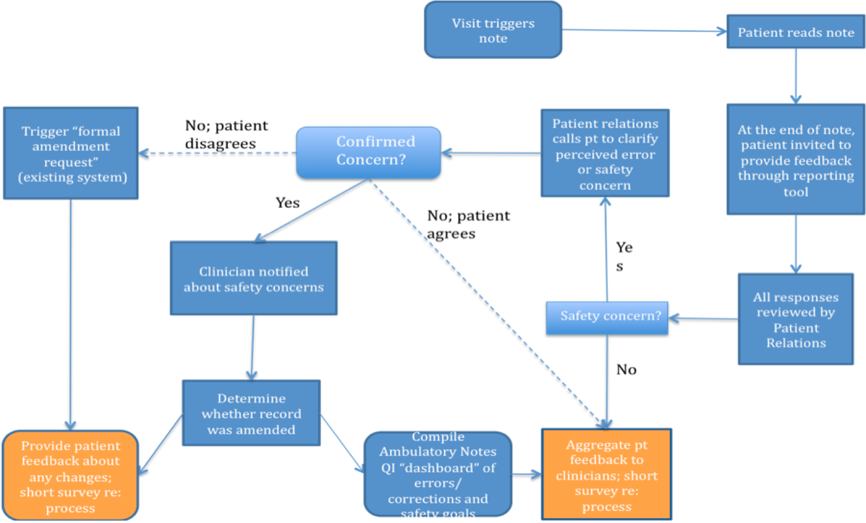
Patient Reporting Tool Flowchart

Slide 31
Potential for OpenNotes to improve safety:
More accurate H and P
Improved health maintenance adherence
Enhanced test/visit/referral follow up
More timely notification of test results
Updated FH
Improved medication accuracy and adherence
Familiarity with facts, allergies, and reminder of instructions
Easier access to charts
“More eyes on the chart”-- opportunity for pts to catch mistakes
Engaged caregivers
Helping patients understand “How Doctors Think”
Opportunity to speak up if symptom(s) unexplained
PCMH model: Enhanced patient-team connection/dynamics
Notes:
Lots of ways…

Slide 32
Pioneering Effective Patient Safety Strategies in the Ambulatory Setting
David Kornoelje, MHA
Clinical Safety and Risk Management Specialist
Atrius Health

Slide 33
Learning Objectives
Recognize barriers for reporting safety events in the ambulatory setting.
Identify interventions for educating staff on what to report and the importance of why to report safety events.
Understand the importance for leadership support.
Identify a mechanism for closing the loop and engaging staff in safety discussions.

Slide 34
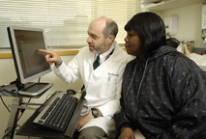
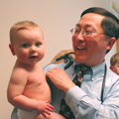
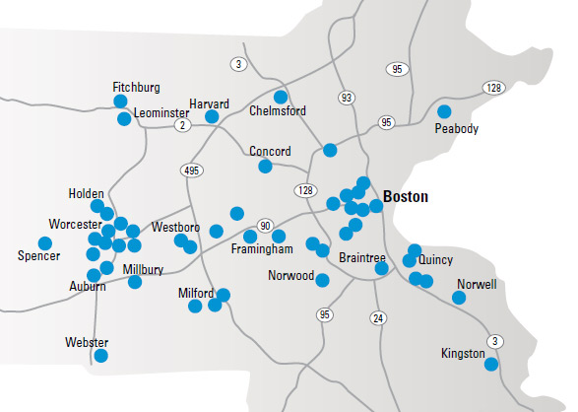
Atrius Health
Non-profit alliance of six leading independent medical groups and a VNA network
  Granite Medical Group
  Dedham Medical Associates
  Harvard Vanguard Medical Associates
  Reliant Medical Group
  Southboro Medical Group
  South Shore Medical Center
  VNA Care Network and Hospice
Providing care for ~ 1,000,000 adult and pediatric patients
1096 Physicians
1450 other healthcare professionals across 35 specialties
7483 Employees
3.8 Million Ambulatory Visits Per Year
VNA Care Network covering Eastern and Central Mass with 750 employees
.

Slide 35
Safety Culture Climate at Atrius Health Group
Reporting of safety events were low and sporadic
  Data suggested only 5 people were carrying the load of reporting, which included 2 physicians and 3 managers
  Learning and improving safety was difficult
Identified barriers for reporting
  Staff unfamiliar with what to report
  Staff perceived reporting to be punitive
  Physicians saw reporting to be too time consuming
  The infamous “black hole”
Review process
  All safety events were reviewed by only the COO
  Minimal events discussed at Safety and Quality Committee

Slide 36
Concept of a Pilot
Pilot was conceptualized to target the top 4 identified barriers at the Atrius Health Group of culture, fear factors, closing the loop, and what to report.
Design of pilot had to be strategically planned for buy-in on all fronts and approval by Atrius Health Group executive leadership.
Meetings with Atrius Health CMO and COO determined pilot area and duration of pilot (4 months to span from September 2013 to December 2013).

Slide 37
Objectives of Pilot
Increase the number of events reported
Increase the number of individual staff reporting safety events
Increase the spread of the types of roles of reporters
Implement a local reviewer to review all safety events originating in the area
Conduct weekly “safety rounds” open to all staff to discuss improvements made or trends identified as a result of safety events being reported.

Slide 38
Events Reported by Month for Pilot Area
531% Increase

Slide 39
Total Group Events Reported by Month
258% Increase

Slide 40
Events Reported by Role of Reporter

Slide 41
The Impact of the “Safety Rounds”
Reduced punitive fears of reporting.
Brought awareness of trends identified through events reported to frontline staff.
Facilitated discussions that involved frontline staff input on possible solutions.
Some physicians started participating.

Slide 42
The Impact of the Local Level Reviewer
Distributed the workload of the event review so that it was not time and labor intensive to the COO.
Better quality reviews occurred with increased level of documentation within the event file.
Improvements made to standard work or policies as a result of events reported were being discussed departmentally.
Assisted with reducing the fears of safety event reporting as being punitive.

Slide 43
Overall Impact of the Pilot on the Group
Executive leadership now supporting the rollout of “safety rounds” and local level reviewers in each clinical area.
Staff are feeling safer to report as evidenced by peer-to-peer encouragement to report.
Physicians are becoming more actively involved in safety event reporting and discussions.
Safety and Quality committee is becoming more structured with their agenda based on the level of meaningful safety events being reported.

Slide 44
Q & A / Discussion

